Slide 1
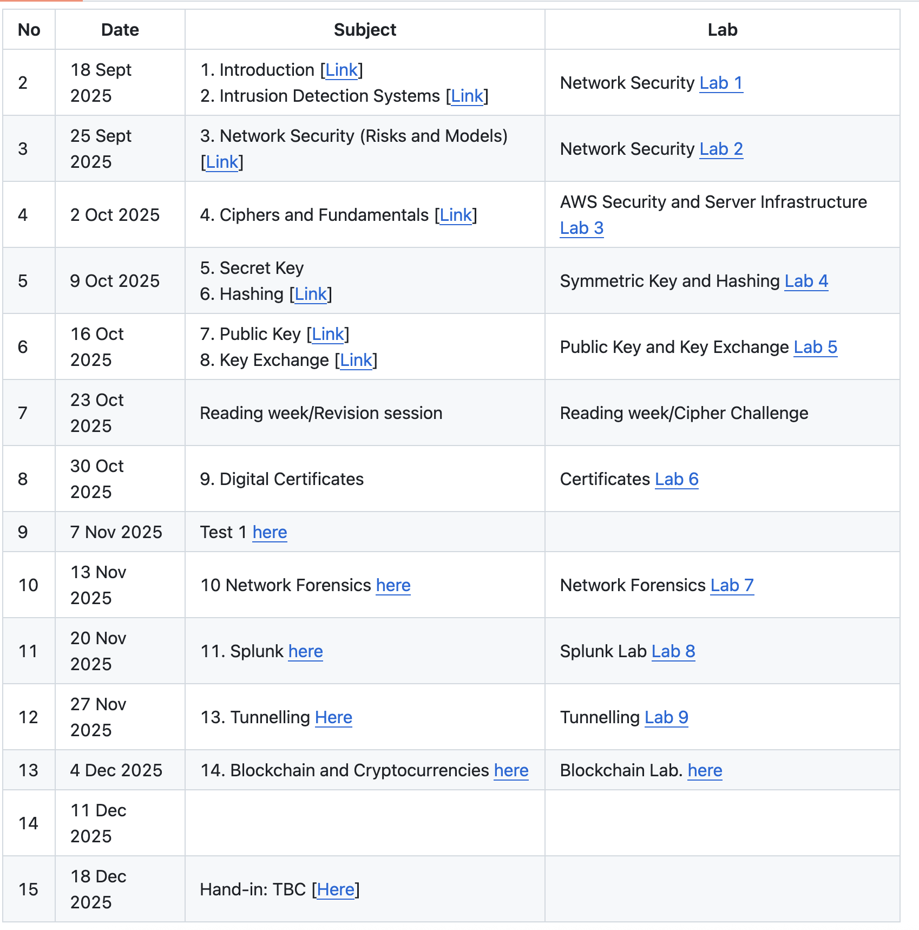
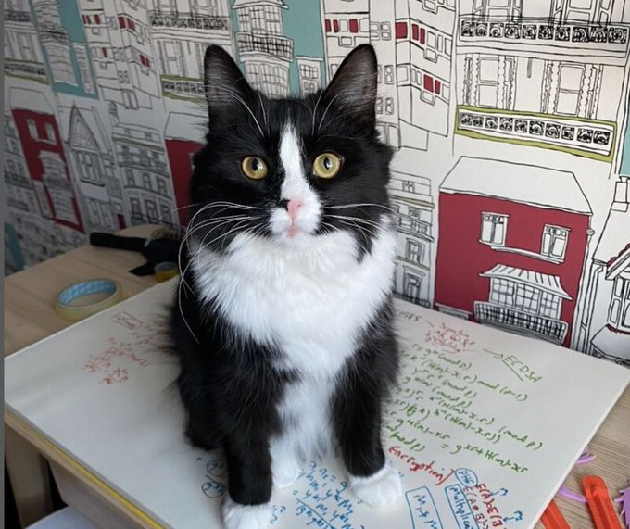
Symmetric Key Basics Block or Stream? Secret Key Methods Salting AES Key Entropy Prof Bill Buchanan OBE, FRSE https://asecuritysite.com/symmetric

Slide 3
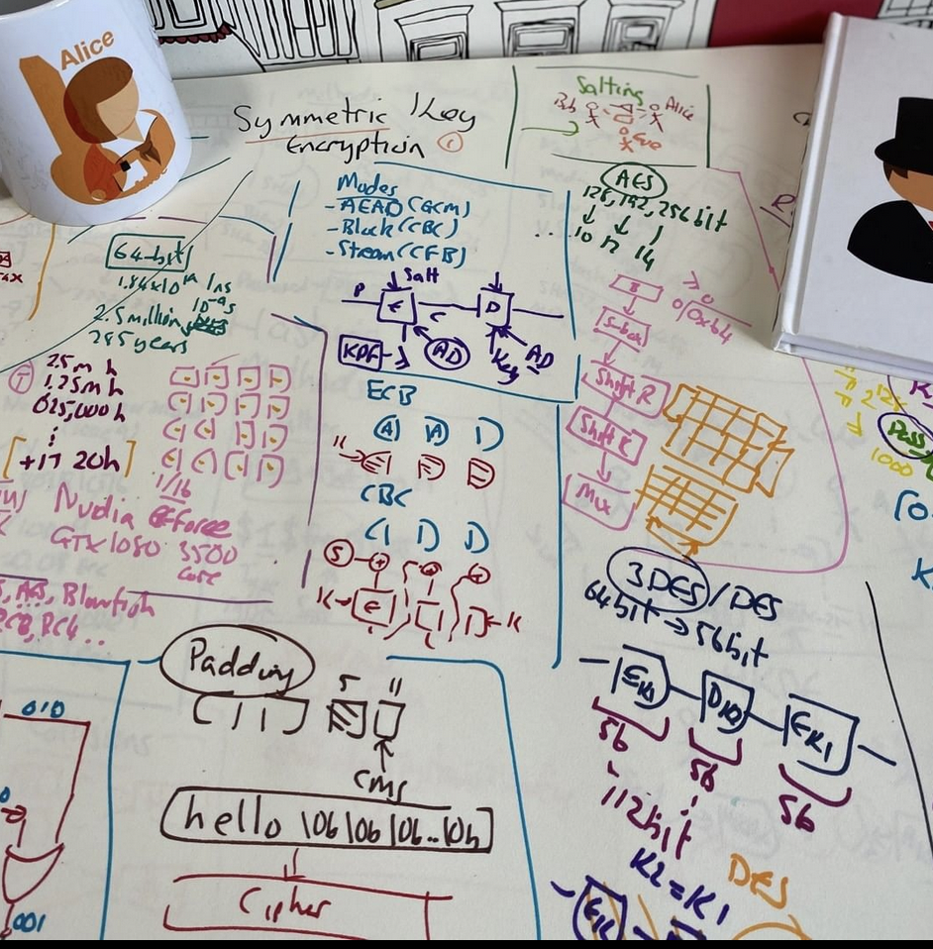
Symmetric Key Basics Block or Stream? Secret Key Methods Salting AES Key Entropy Prof Bill Buchanan OBE, FRSE https://asecuritysite.com/symmetric

Slide 5
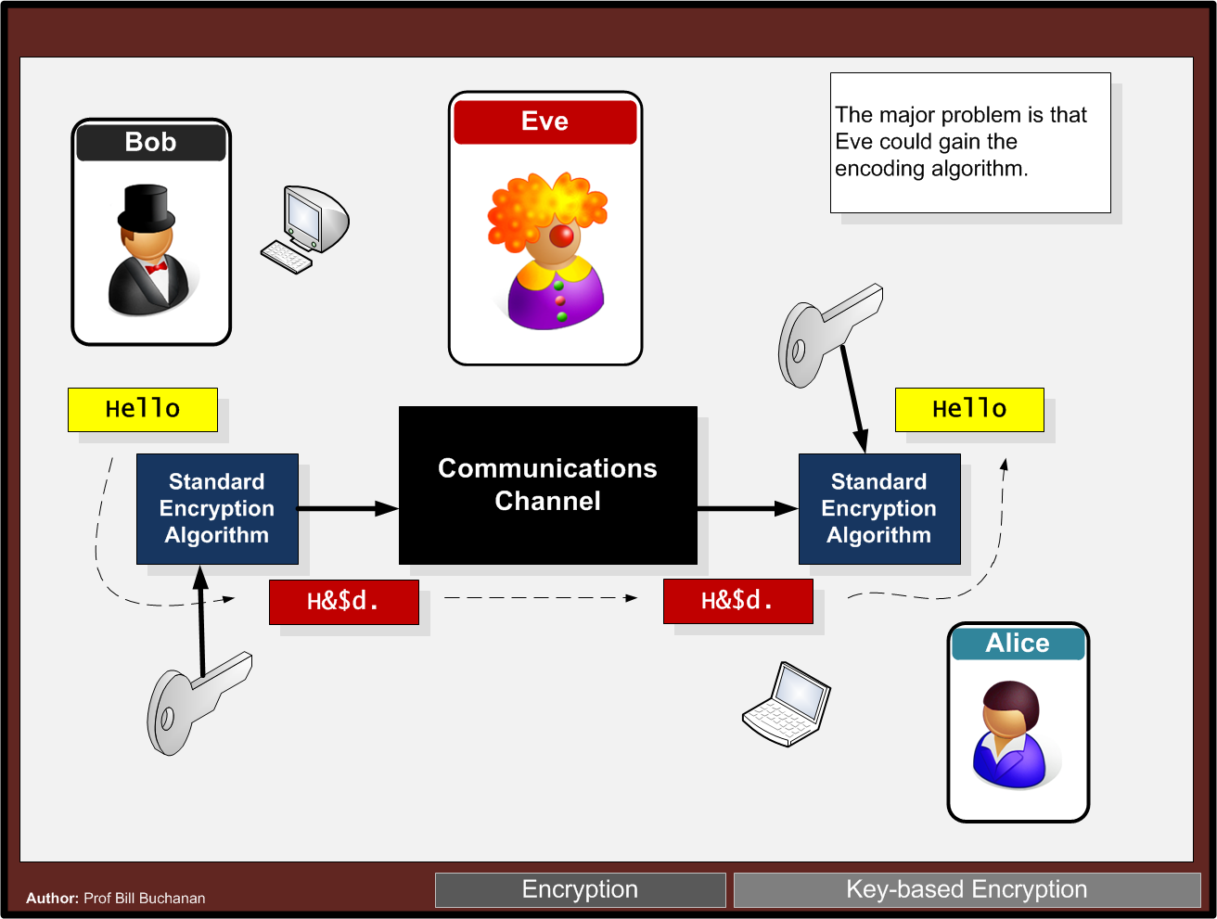

Slide 6
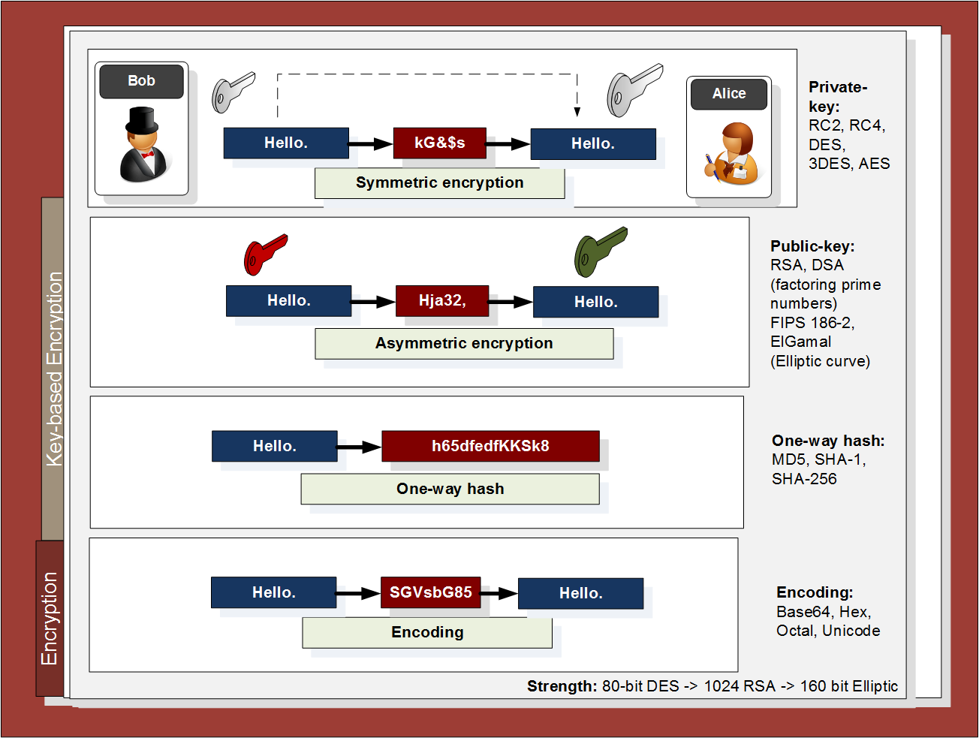

Slide 7
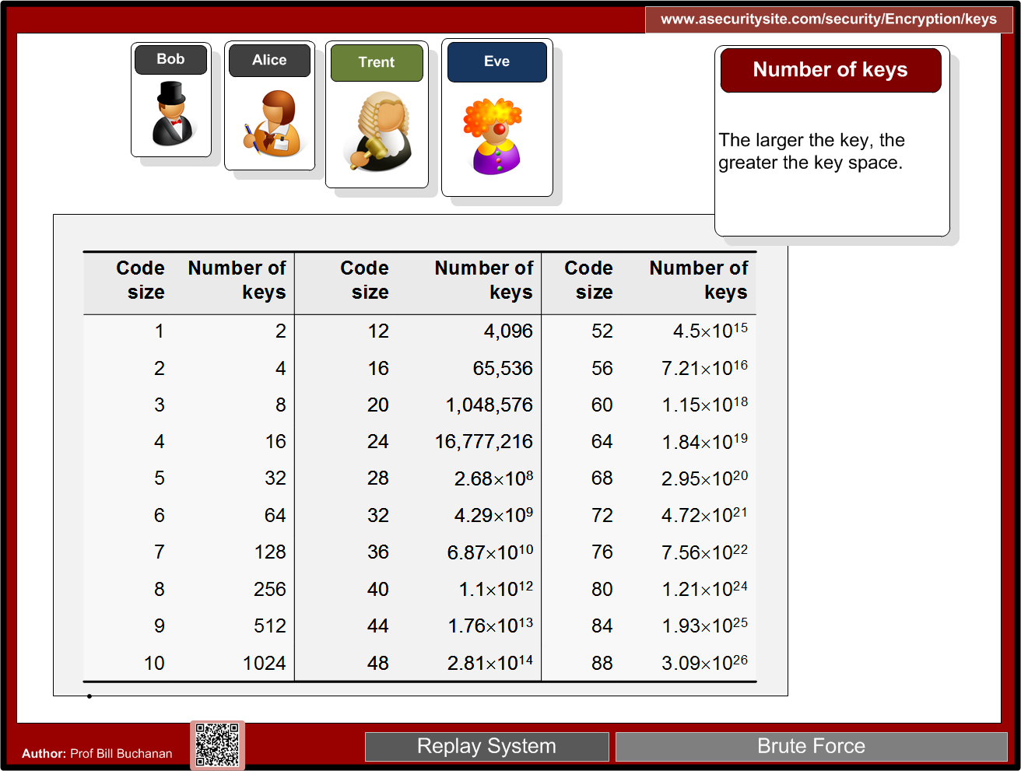
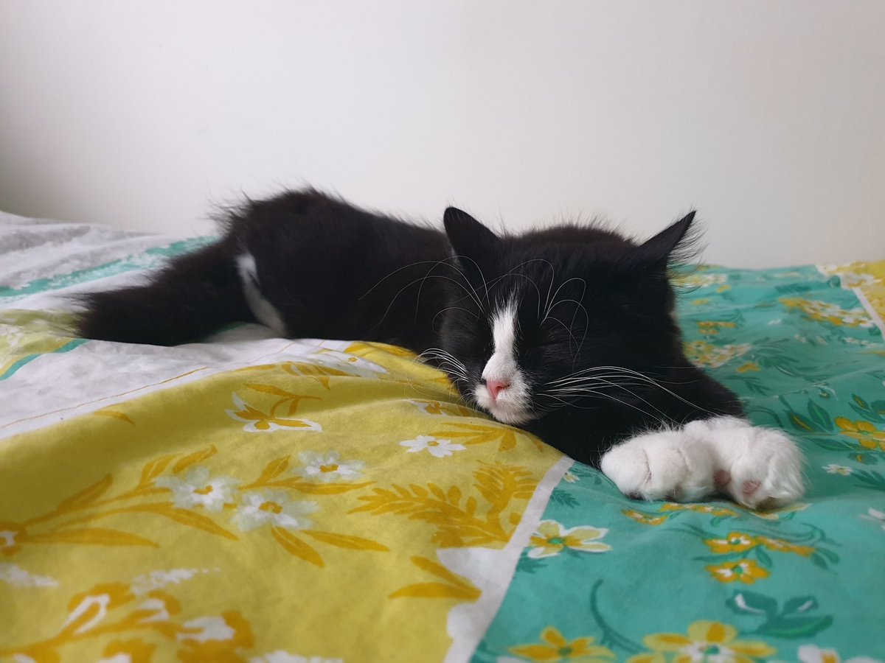
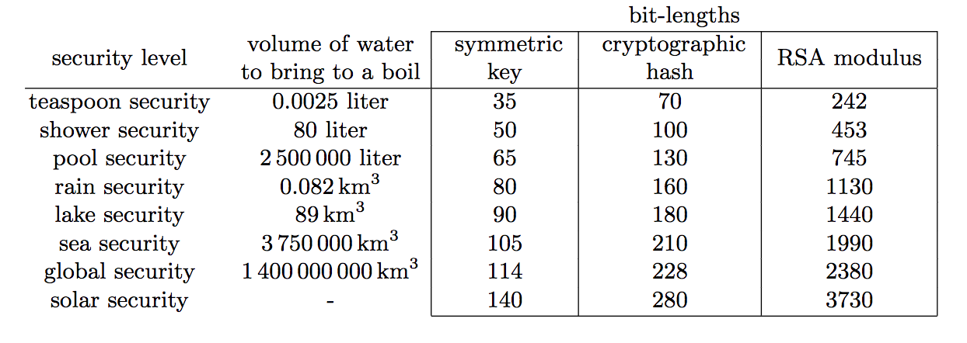

Slide 8
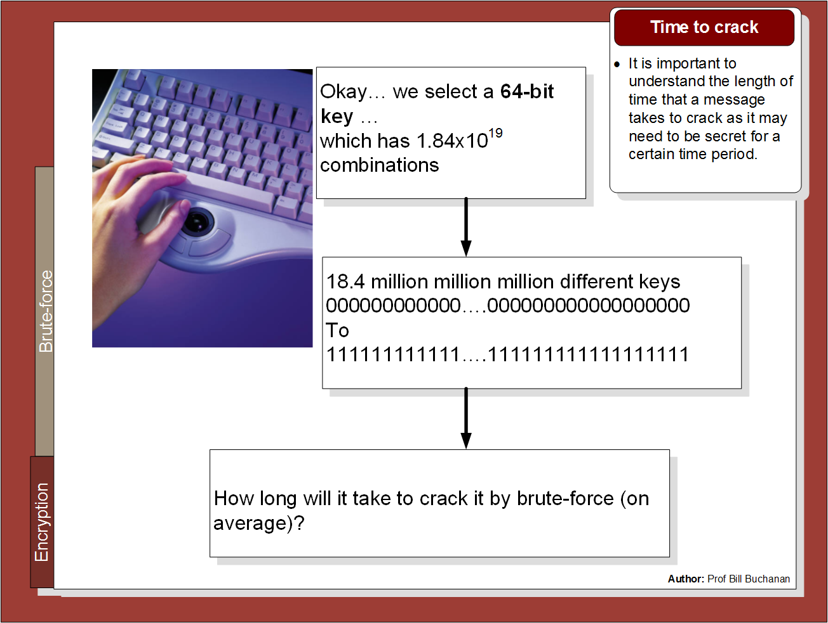

Slide 9
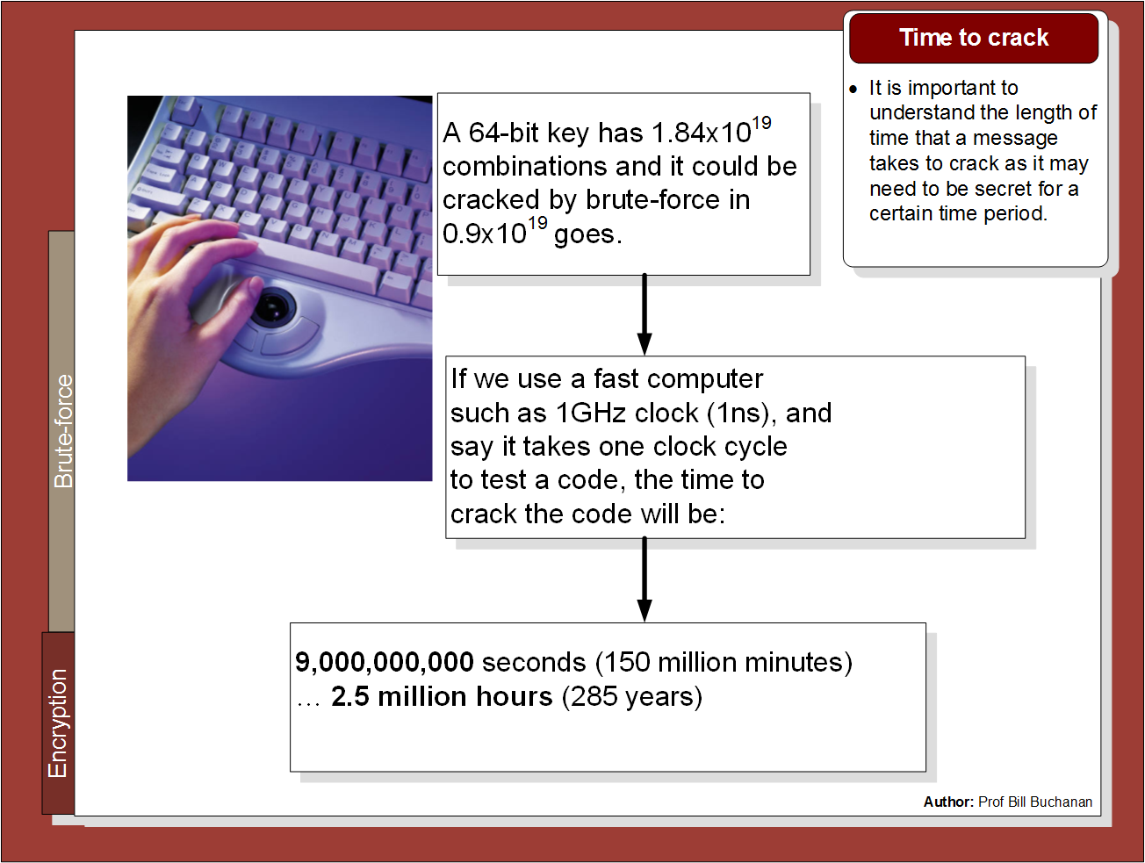

Slide 10
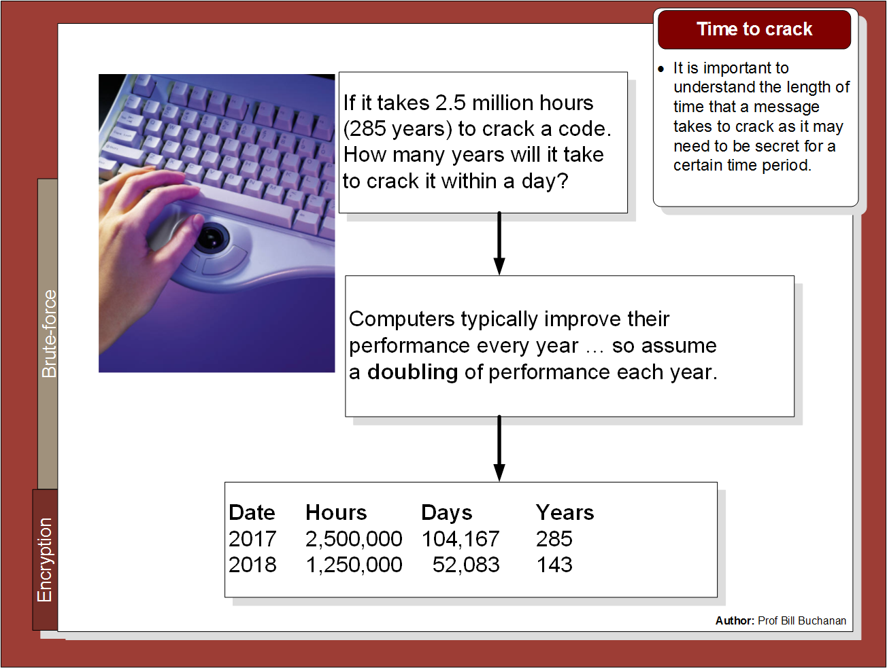

Slide 11
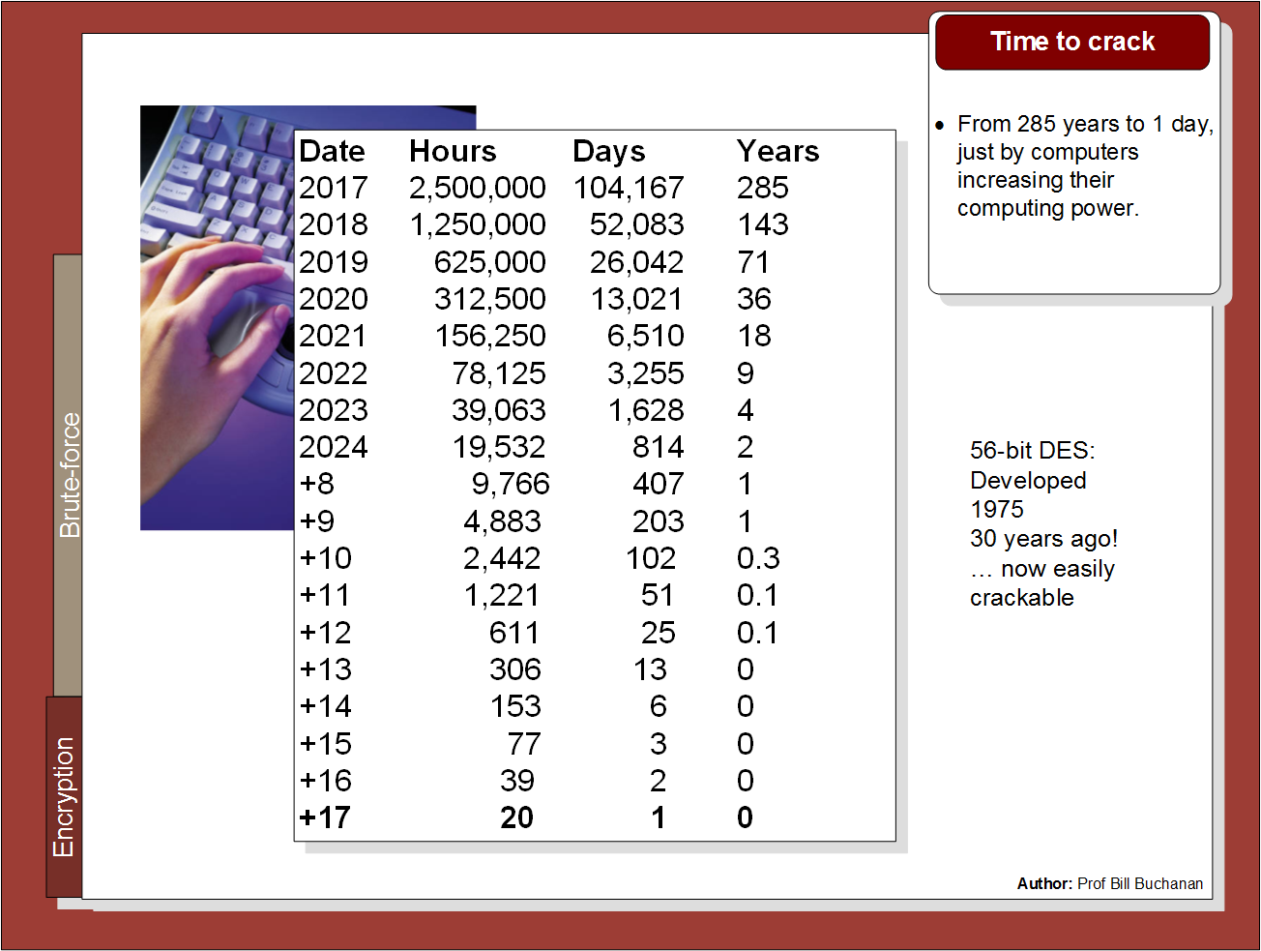

Slide 12
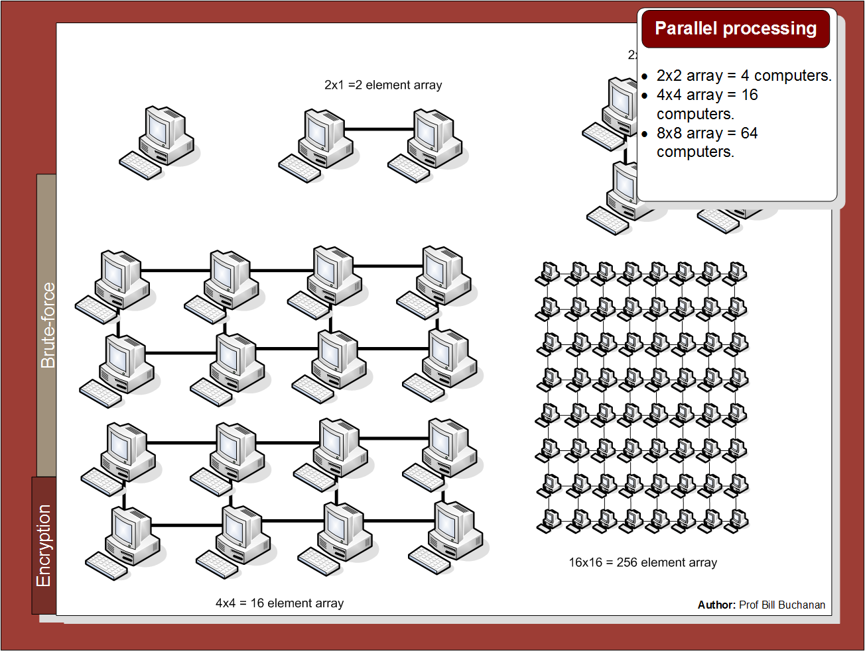

Slide 13
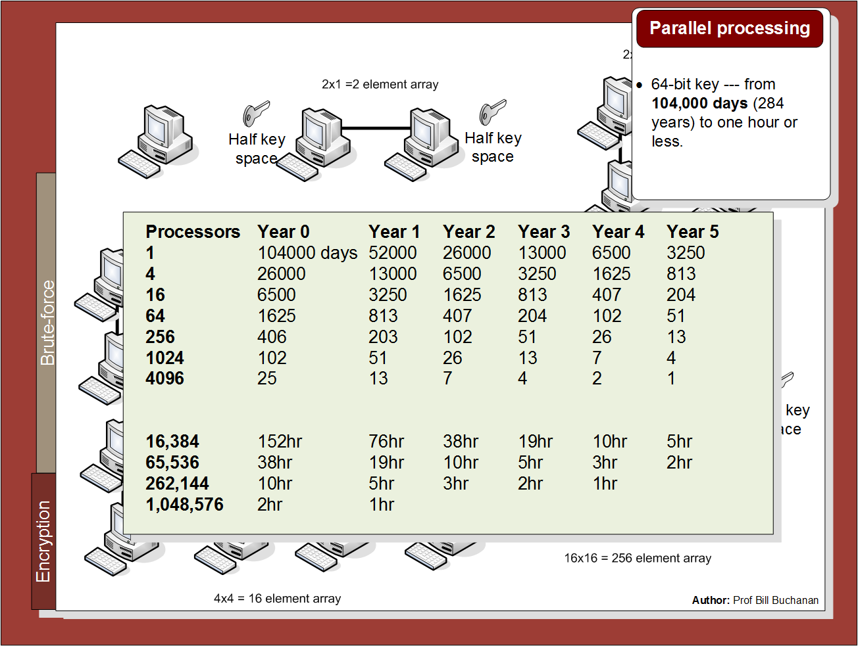

Slide 14
Symmetric Key Basics Block or Stream? Secret Key Methods Salting AES Key Entropy Prof Bill Buchanan OBE https://asecuritysite.com/symmetric

Slide 15
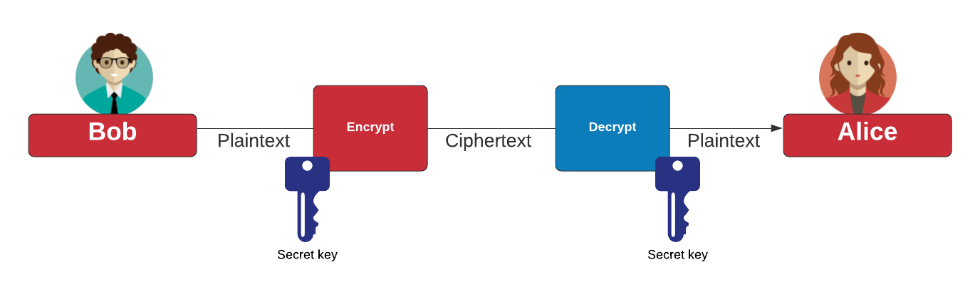
Symmetric Key
Block cipher: AES (128-bit block), DES (64-bit block), 3DES (64-bit block), Blowfish, SM4, Camellia, GOST, IDEA, RC2, Serpent, Skipjack, Twofish, and XTEA Stream cipher: ChaCha20, AES GCM, ARIA, Sala20, and RC4. AES also known as Rijndael (after Joan Daemen and Vincent Rijmen). ChaCha20 created by Daniel J Bernstein. Blowfish and Twofish created by Bruce Schneier.

Slide 16
Number of keys

Slide 17
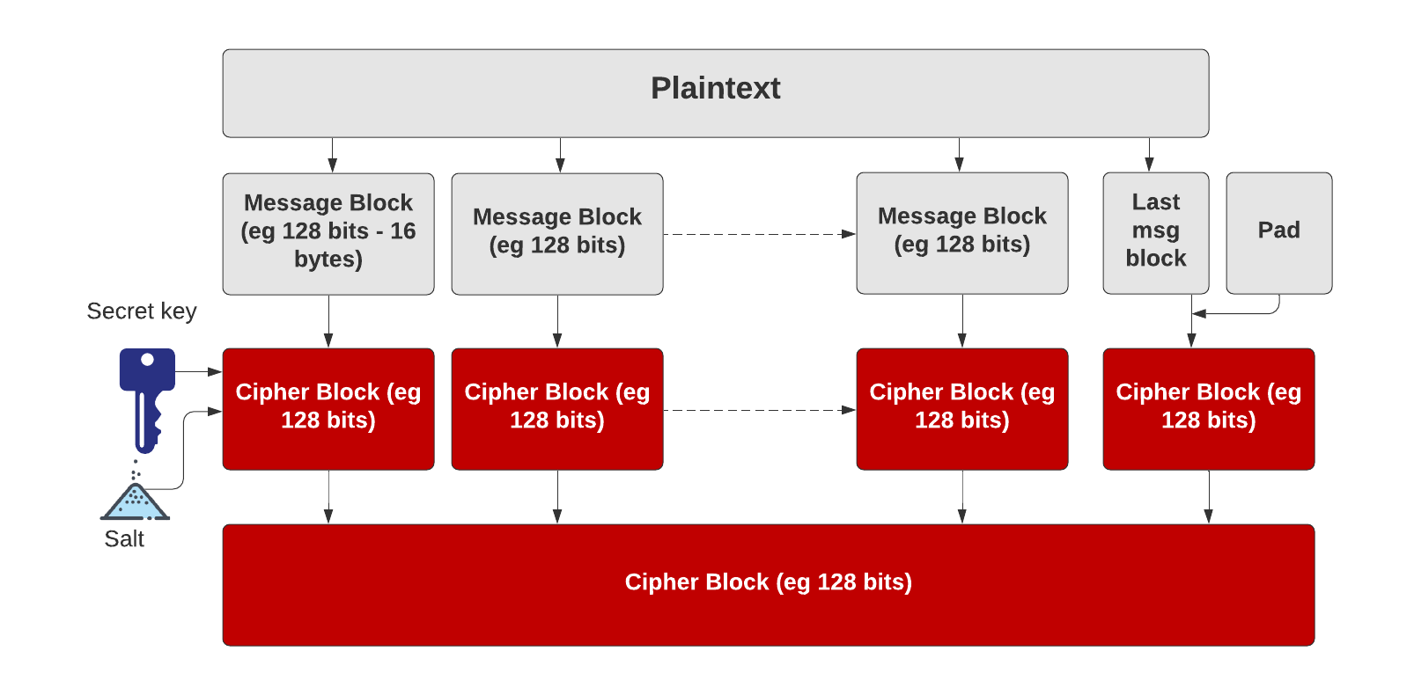
Symmetric Key – Block cipher
https://asecuritysite.com/golang/go_pad

Slide 18
Symmetric Key – Block cipher
https://asecuritysite.com/golang/go_pad

Slide 19
Padding
CMS (Cryptographic Message Syntax). This pads with the same value as the number of padding bytes. Defined in RFC 5652, PKCS#5, PKCS#7 and RFC 1423 PEM.
Bits. This pads with 0x80 (10000000) followed by zero (null) bytes. Defined in ANSI X.923 and ISO/IEC 9797-1.
ZeroLength. This pads with zeros except for the last byte which is equal to the number (length) of padding bytes.
Null. This pads will NULL bytes. This is only used with ASCII text.
Space. This pads with spaces. This is only used with ASCII text.
Random. This pads with random bytes with the last byte defined by the number of padding bytes.

Slide 20
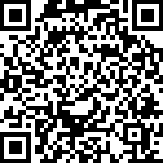
Padding
After padding (CMS): 68656c6c6f0b0b0b0b0b0b0b0b0b0b0b Cipher (ECB): 0a7ec77951291795bac6690c9e7f4c0d
After padding (Bit): 68656c6c6f8000000000000000000000 Cipher (ECB): 731abffc2e3b2c2b5caa9ca2339344f9
After padding (ZeroLen): 68656c6c6f000000000000000000000a Cipher (ECB): d28e2f7e8e44e068732b292bde444245
After padding (Null): 68656c6c6f0000000000000000000000 Cipher (ECB): 444797422460453d95856eb2a1520ece
After padding (Random): 68656c6c6ffc6ecfd884a38798d62a0a Cipher (ECB): c2c88b4364d2c2dc6f2cac9ab73c995d
https://asecuritysite.com/hazmat/hashnew28

Slide 21
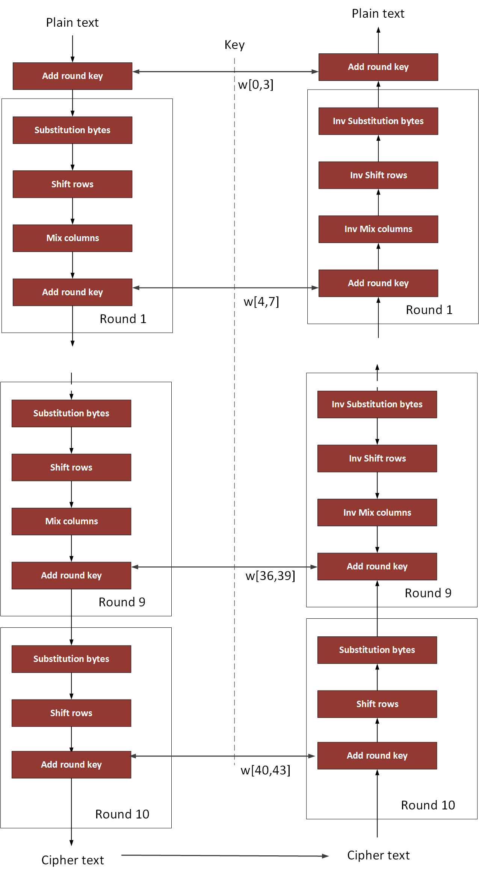
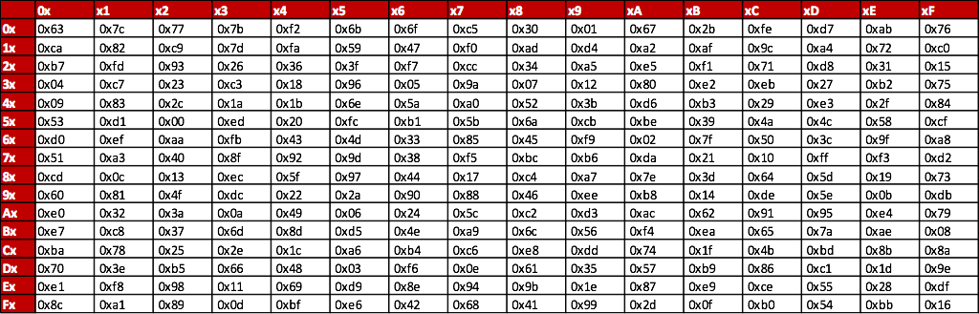
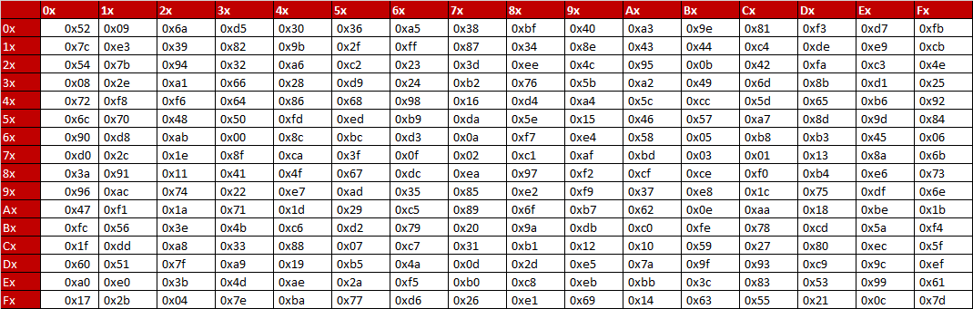
AES
10 rounds for 128-bit keys.
12 rounds for 192-bit keys.
14 rounds for 256-bit keys.
NIST

Slide 22
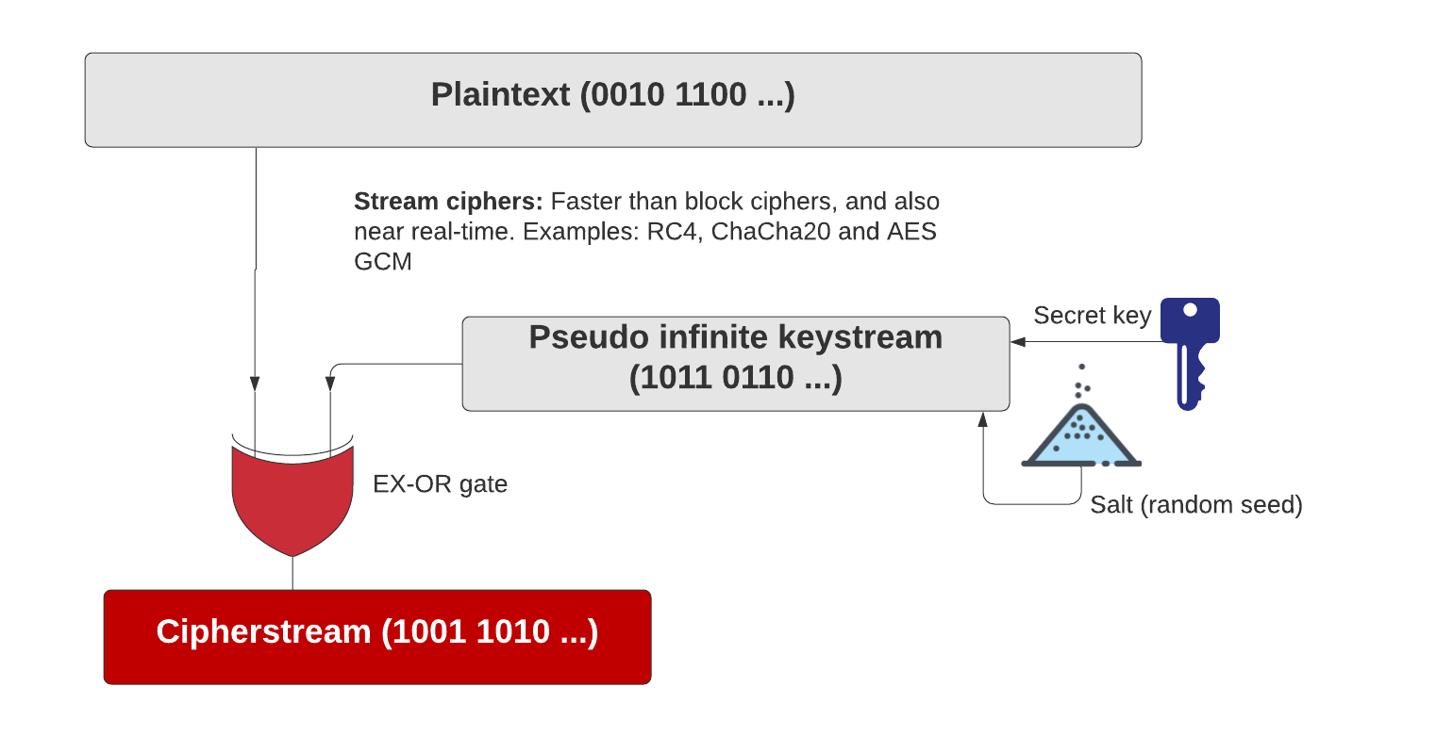
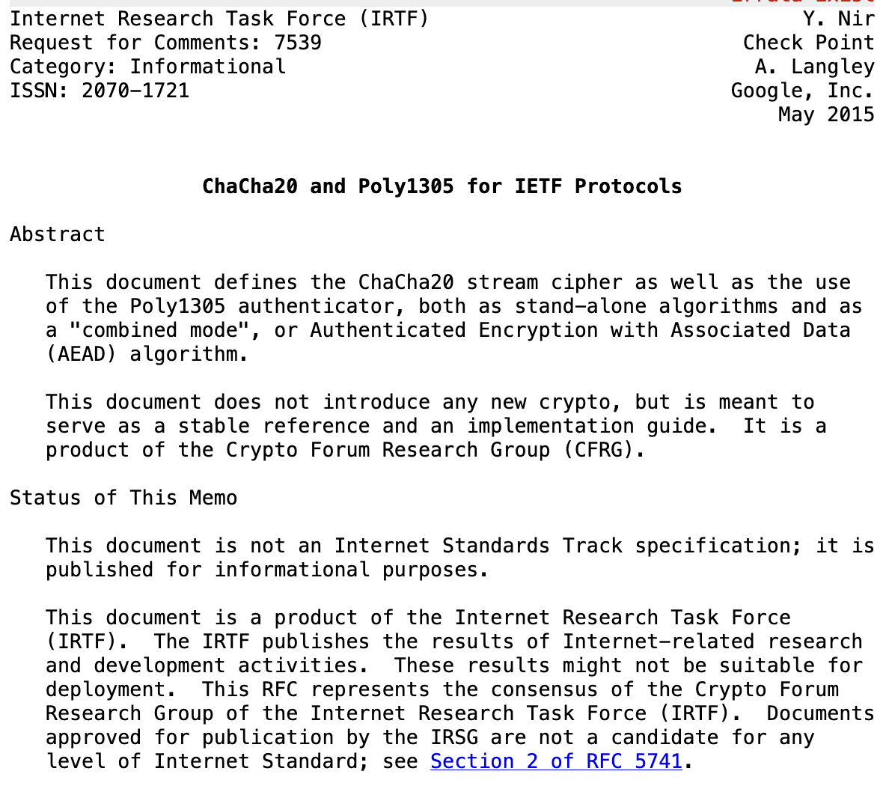
Symmetric Key – Stream cipher
https://asecuritysite.com/golang/go_chacha

Slide 23
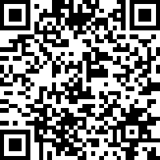
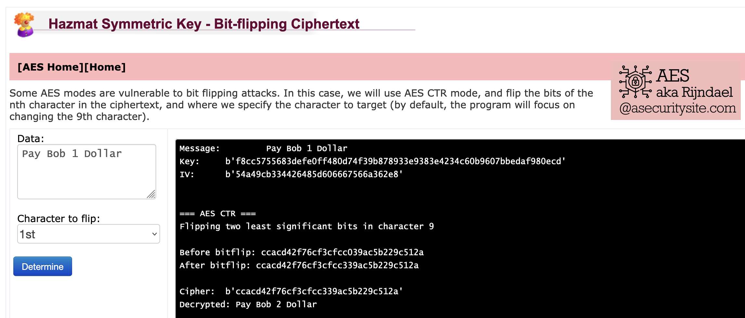
Cipher Cracking
https://asecuritysite.com/aes/hashnew4a

Slide 24
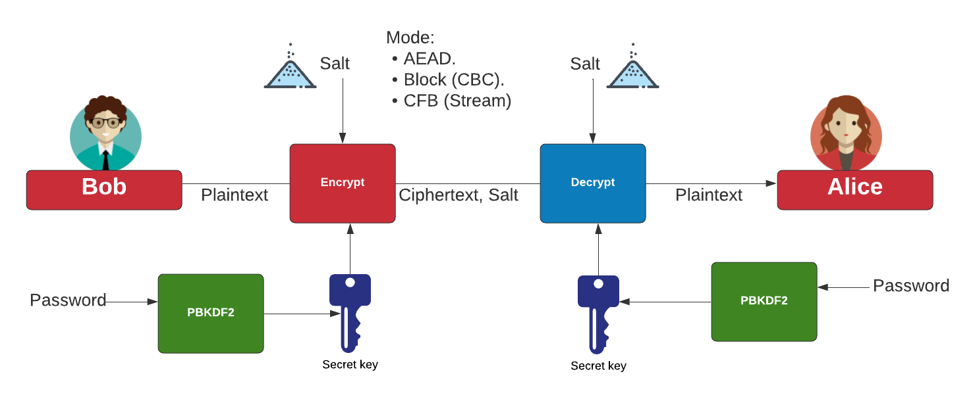
Symmetric Key - Modes
AES Block cipher modes: ECB (No salt), CBC (Cipher Block Chaining).
AES Stream modes: CFB (Cipher Feedback), OFB (Output Feedback), CTR (Counter), GCM (Galois Counter Mode).
https://asecuritysite.com/golang/go_symmetric

Slide 25
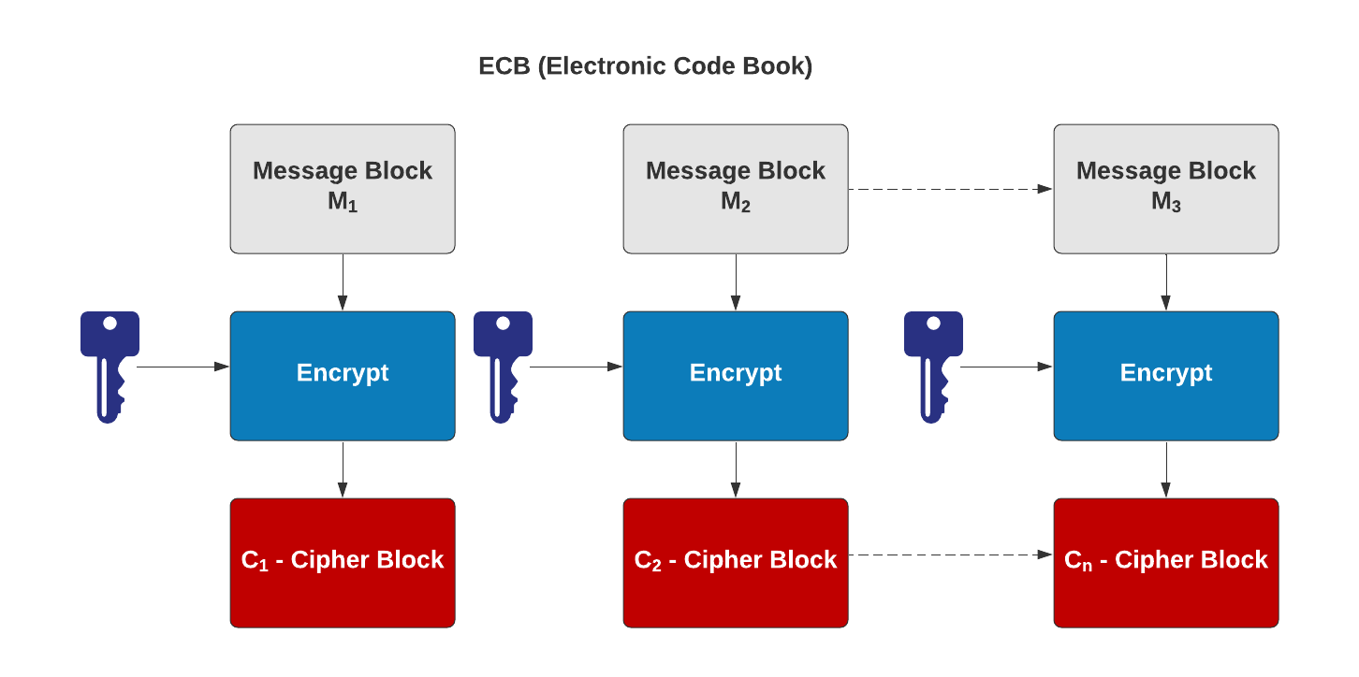
Symmetric Key – Electronic Code Code (ECB)
AES Block cipher modes: ECB (No salt), CBC (Cipher Block Chaining).
AES Stream modes: CFB (Cipher Feedback), OFB (Output Feedback), CTR (Counter), GCM (Galois Counter Mode).
https://asecuritysite.com/hazmat/hashnew4

Slide 26
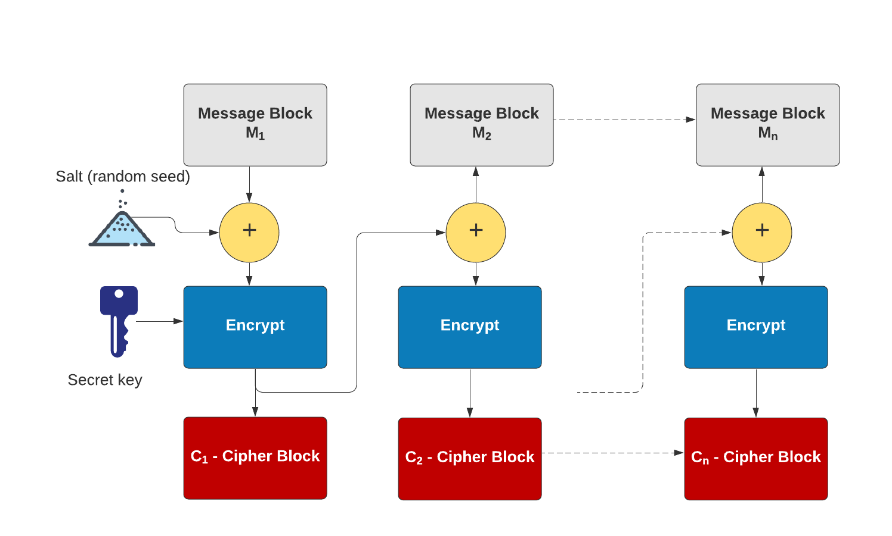
Symmetric Key – Cipher Block Chaining (CBC)
AES Block cipher modes: ECB (No salt), CBC (Cipher Block Chaining).
AES Stream modes: CFB (Cipher Feedback), OFB (Output Feedback), CTR (Counter), GCM (Galois Counter Mode).
https://asecuritysite.com/golang/go_symmetric

Slide 27
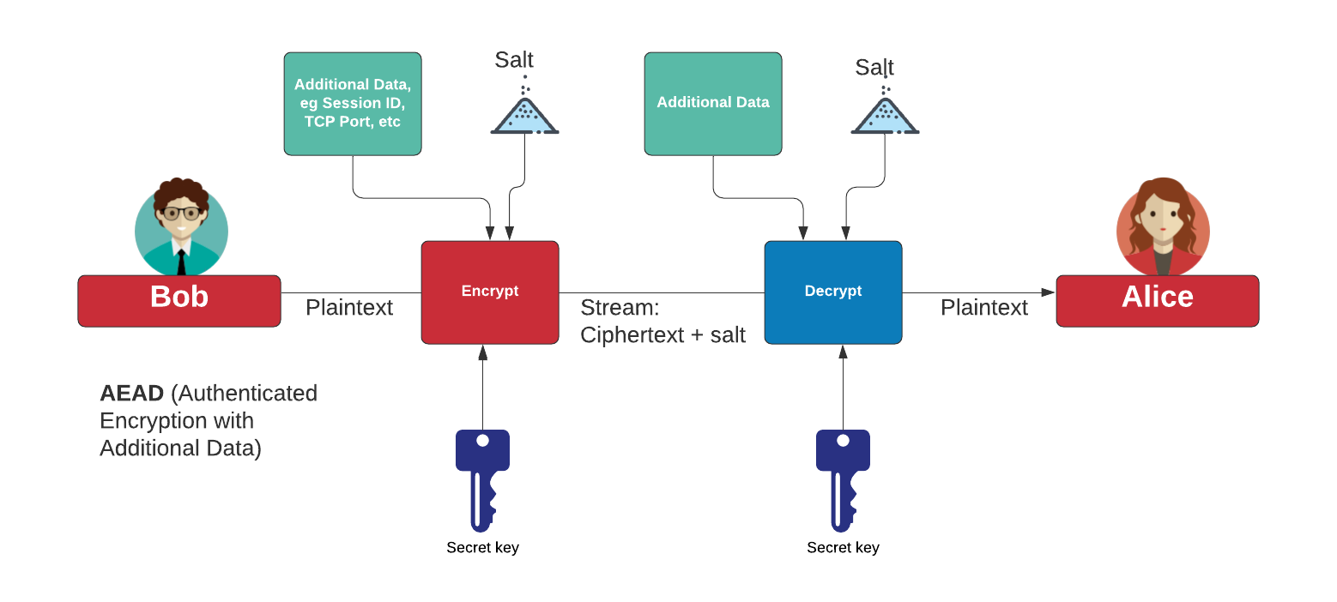
Authenticated Encryption with Additional Data (AEAD)
AES Block cipher modes: ECB (No salt), CBC (Cipher Block Chaining).
AES Stream modes: CFB (Cipher Feedback), OFB (Output Feedback), CTR (Counter), GCM (Galois Counter Mode).
https://asecuritysite.com/golang/go_symmetric

Slide 28
Symmetric Key – GCM (Galois Counter Mode)
https://asecuritysite.com/hazmat/hashnew21

Slide 29
Symmetric Key Basics Block or Stream? Secret Key Methods Salting AES Key Entropy Prof Bill Buchanan https://asecuritysite.com/symmetric

Slide 30
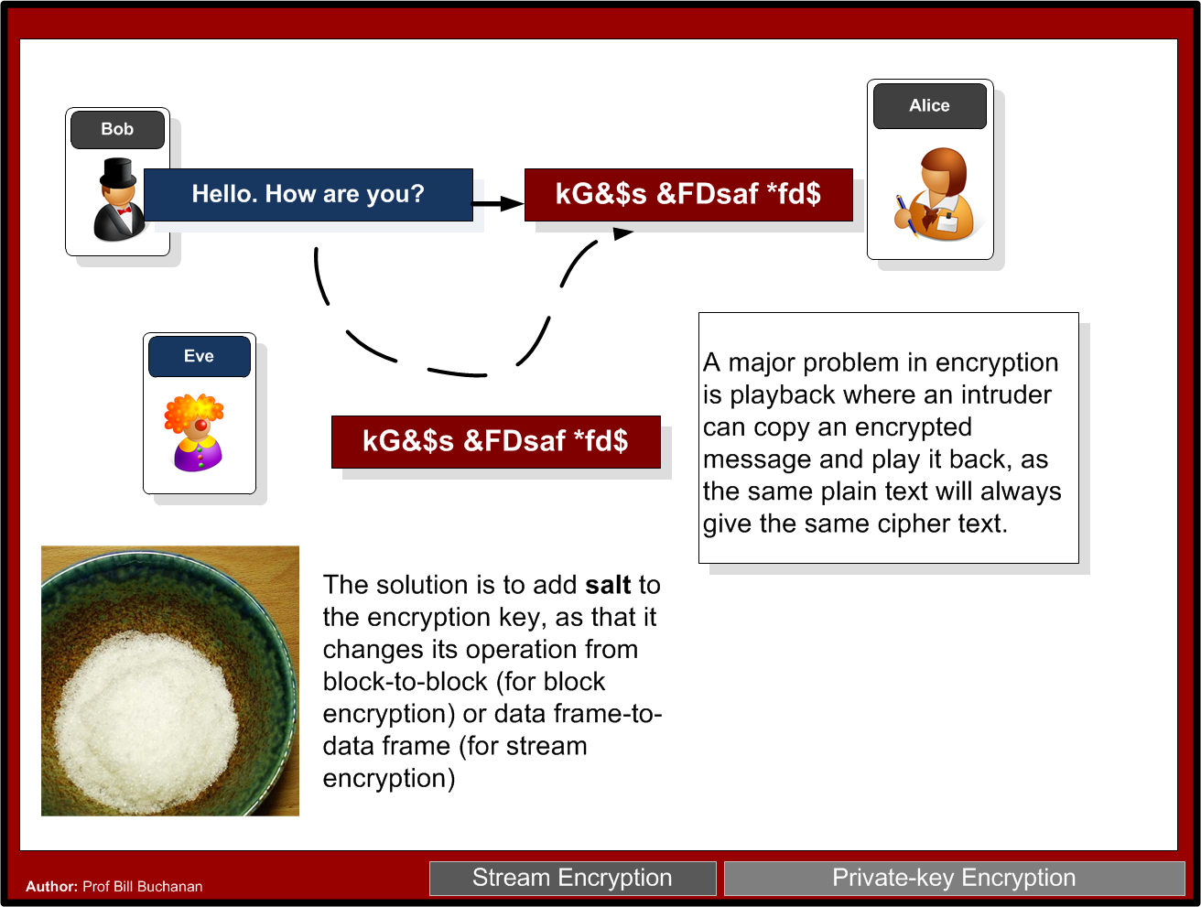

Slide 31
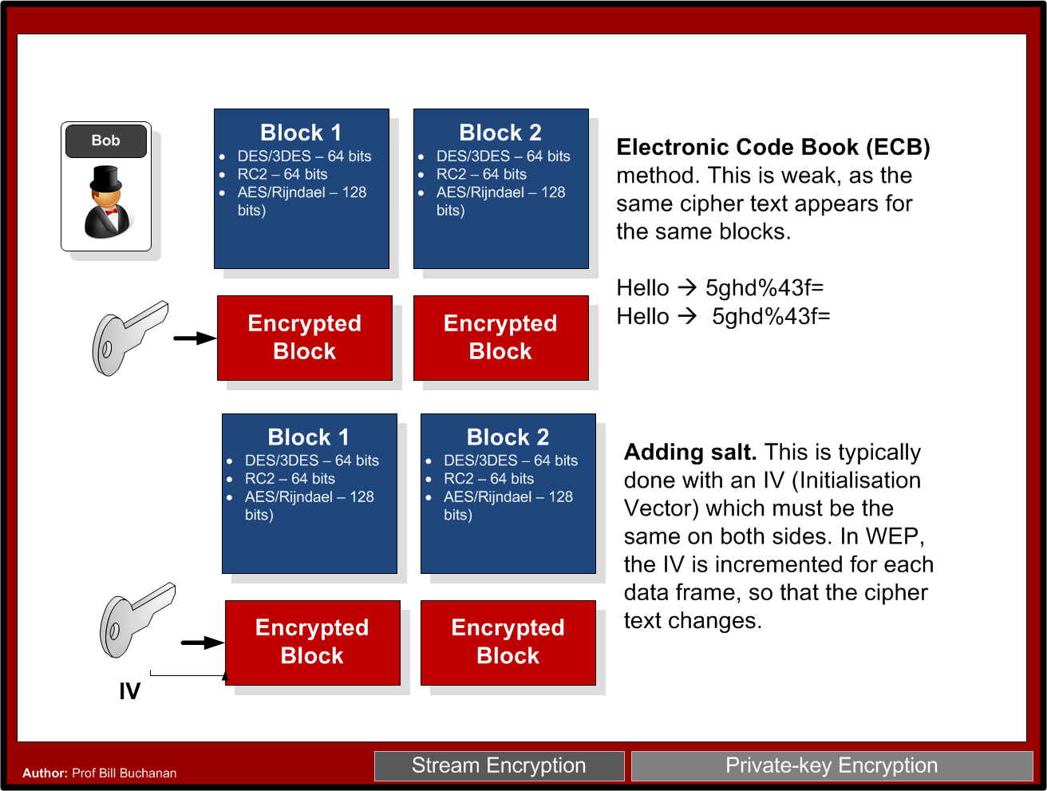

Slide 32
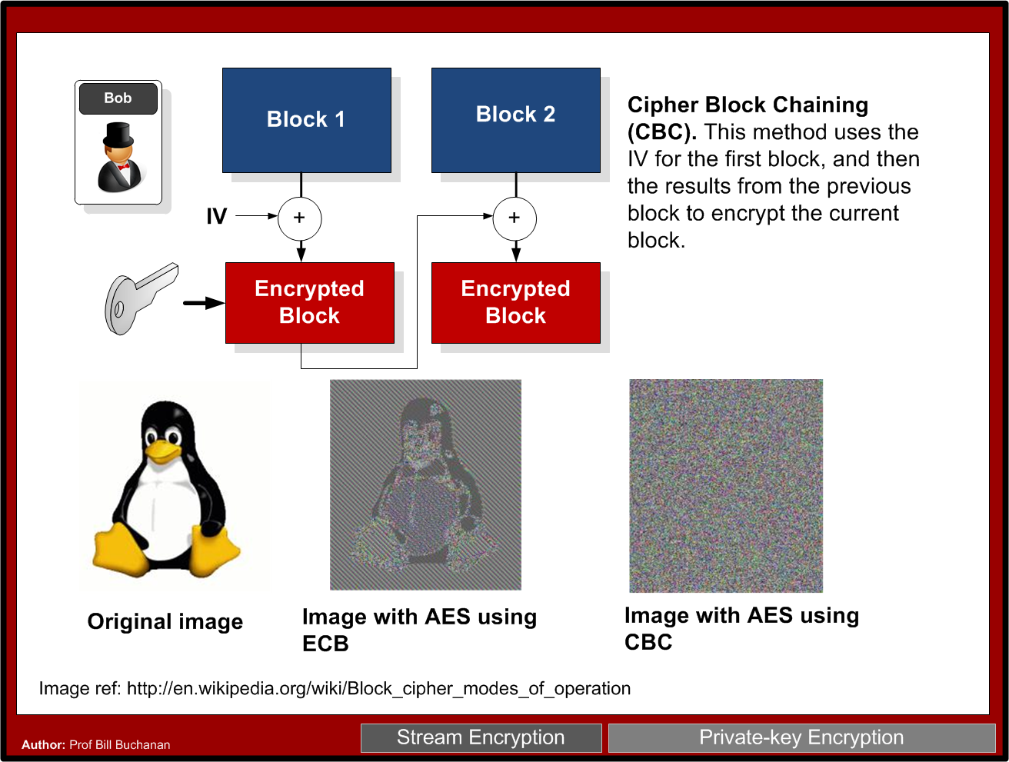

Slide 34
Symmetric Key Basics Block or Stream? Secret Key Methods Salting AES Key Entropy Prof Bill Buchanan https://asecuritysite.com/symmetric

Slide 35
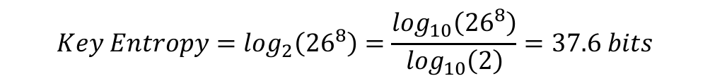
Key Entropy
Password entropy
Password entropy
Password definition | Number of possible characters | Total number of passwords | Entropy (bits)
[0-9] | 10 | 100,000,000 | 26.6
[a-z] | 26 | 2.08827x10¹¹ | 37.6
[a-zA-Z] | 52 | 5.34597x10¹³ | 45.6
[a-zA-Z0-9] | 62 | 2.1834x10¹⁴ | 47.6
[a-zA-Z0-9$%!@+=] | 68 | 4.57163x10¹⁴ | 48.7

Slide 36
Symmetric Key Basics Block or Stream? Secret Key Methods Salting AES Key Entropy Prof Bill Buchanan OBE https://asecuritysite.com/symmetric

